Slide 1
I Got Custom Widgets, Shapes, and Geo-Spatial Data… You can too!
A step by step introduction to using sql spatial functions to do cool tricks with geo spatial queries and getting them displayed as tableau polygons.

Slide 2
You will learn how to:
Use SQL spatial features for the first time (in MS SQL/SERVER)
Use a table valued function in SQL Server as a date source
Draw shapes using spatial point, line and curve descriptions
Turn a geometry object into a list of points
Put it all together to create custom widgets, shapes, and spatial results in Tableau
Everything is on GitHub so sit back and relax!

Slide 3
SQL Server Spatial Features
Included in all versions of since SQL Server 2008+ (Add on for 2008)
Geometry – flat Euclidian coordinate system
Geography - round-earth coordinate system
Mercator projection most common format
It’s free and very cool, why not use it?

Slide 4
SQL Spatial geometry types
Point
LineString
CircularString
CompoundCurve
Polygon
CurvePolygon
MultiPoint
MultiLineString
MultiPolygon
GeometryCollection

Slide 5
FACTS ABOUT Shapes and polygons
Shapes are described using points, lines, and curves
Text descriptions are turned into binary objects that can be transformed using geometry functions geometry='LINESTRING (1 1, 3 3)'
Binary objects can also be stored in the SQL database
https://docs.microsoft.com/en-us/sql/relational-databases/spatial/spatial-data-types-overview

Slide 6
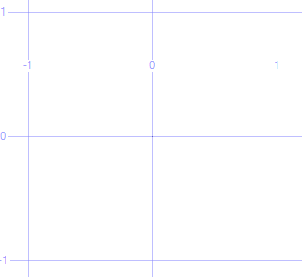
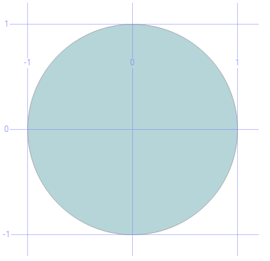
Draw a point, then turn it into a circle
SELECT geometry::Point(0,0,0) AS Point
DECLARE @point geometry
SET @point = geometry::Point(0,0,0)
DECLARE @circle geometry
--STBuffer function adds area(width) to any geometry object
SET @circle = @point.STBuffer(1)
SELECT @circle AS Circle
It’s really there… believe me!

Slide 7
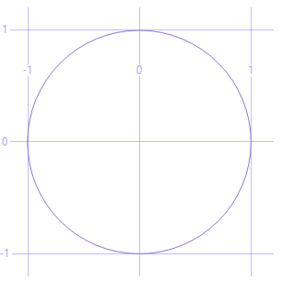
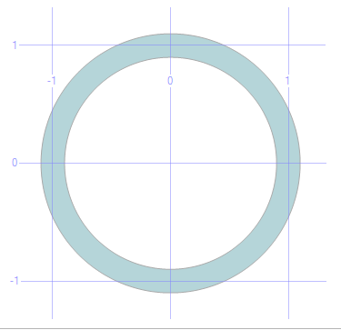
Let’s draw a RING
DECLARE @g geometry
SET @g = geometry::Parse('CIRCULARSTRING(1 0, 0 1, -1 0, 0 -1, 1 0)');
SELECT @g AS Ring
SET @g = @g.STBuffer(.1)
SELECT @g AS BufferedRing

Slide 8
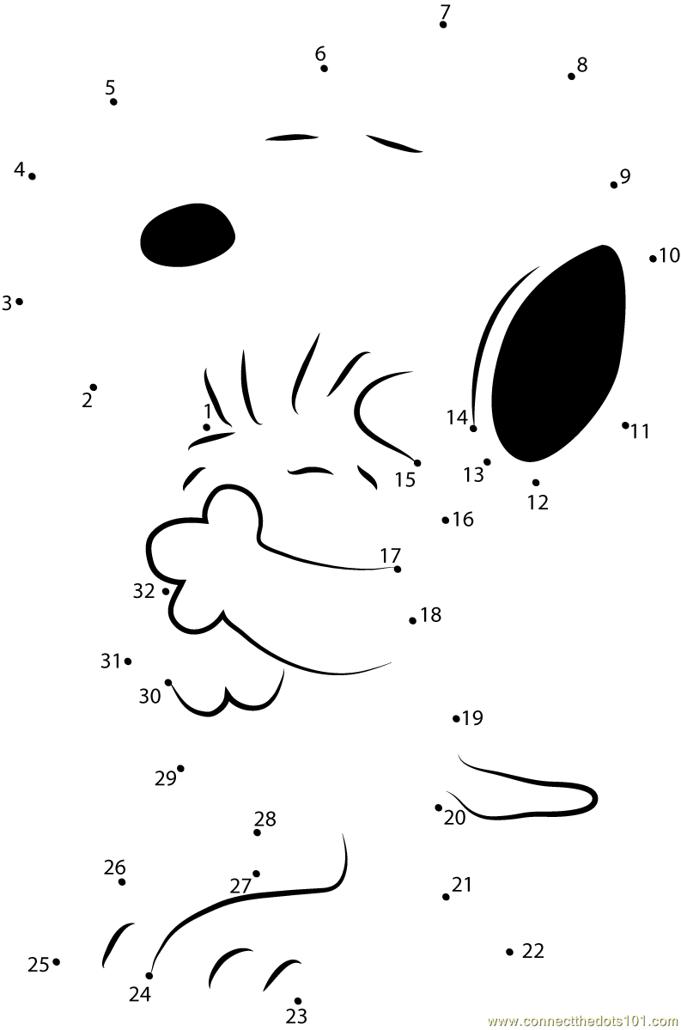
NOW HOW DO WE GET FROM THIS…

Slide 9

NOW HOW DO WE GET FROM THIS…
TO THIS?

Slide 10
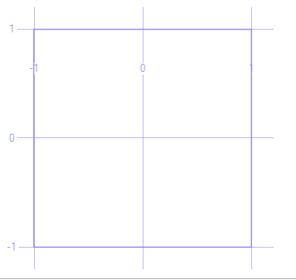
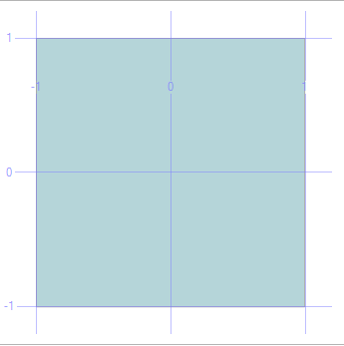
CONNECTTING THE DOTS
DECLARE @square geometry
SET @square= 'LineString(1 1, 1 -1, -1 -1, -1 1, 1 1)'
SELECT @square AS [Square]
DECLARE @square_solid geometry
SET @square_solid = 'Polygon((1 1, 1 -1, -1 -1, -1 1, 1 1))'
SELECT @square_solid AS [SolidSquare]
POLYGONS MUST ALWAYS be closed (last point = first point)

Slide 11
Lines vs. polygons : to fill or not to fill
TABLEAU doesn’t know the difference between closed lines and polygons
TABLEAU will always connect the last point to the first point and fill the shape
If you want “lines”, they must have width
If you want “lines”, you need to draw thin polygons
The good news is that a spatial buffer command will do that for you
It is a good practice to always close your polygon in Tableau; make your last point have the same coordinates as your first point

Slide 12
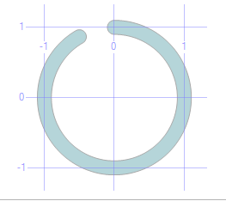

DRAWING A PERCENT METER
-- Be sure to start at 12 o'clock (0,1) and go clockwise to 83.3% (300 degrees)
DECLARE @g geometry
SET @g = geometry::Parse('CIRCULARSTRING(0 1, 1 0, 0 -1, -1 0, -0.5 0.866)');
SET @g = @g.STBuffer(.1)
SELECT @g AS BufferedRing
--But these are curves, we need Points to plot for Tableau
SET @g = @g.STCurveToLine();
SELECT @g.STNumPoints() AS NumberOfPoints

Slide 13
We need another cool tool here
TABLE VALUED FUNCTIONS (tvf) :
Written in (TSQL) script like a function
Can take arguments
Looks and acts just like a data table

Slide 14
ADD THE MAGIC SAUCE TO TURN POINTS INTo A TABLE
CREATE FUNCTION [dbo].[tvfGetPolygonPoints] (@polygon geometry) RETURNS
@polypoints TABLE (PointID int, PointX float, PointY float)
AS
BEGIN
DECLARE @i INT = 1;
WHILE (@i <= @polygon.STNumPoints())
BEGIN
INSERT INTO @polypoints
SELECT @i, @polygon.STPointN(@i).STX AS PointX, @polygon.STPointN(@i).STY AS PointY;
SET @i = @i + 1
END
INSERT INTO @polypoints
SELECT @i, @polygon.STPointN(1).STX AS PointX, @polygon.STPointN(1).STY AS PointY;
RETURN;
END

Slide 15
LOTS OF POINTS TO PLOT
SET @g = @g.STCurveToLine()
SELECT * FROM [dbo].[tvfGetPolygonPoints](@g)

Slide 16
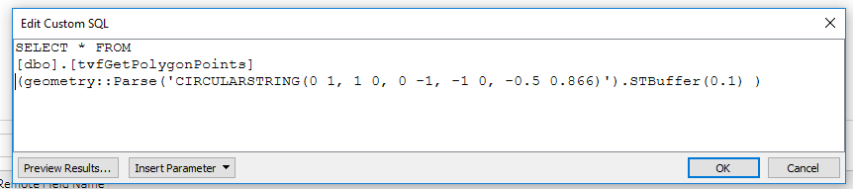
SO HOW DO we get this back into tableau?
Add Custom SQL data source and SELECT columns (or *) from our tvf

Slide 17
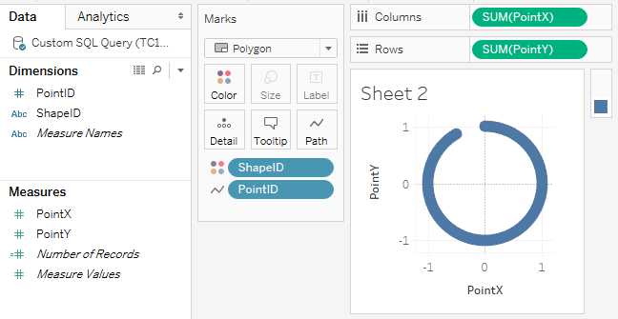
BAMMMM!!!

Slide 18
Truth be told… I wanted to DO THIS SESSION
For all to learn how to do something fun with SQL Spatial commands even if you don’t have spatial data right now.
These features are there in every box and no one should be scared of them.
If you know that they are there, you can make them do some very cool stuff.
And, sooner or later, you will probably figure out how to use those fancy geospatial functions for geospatial data.

Slide 19
TheSE videoS run through some more advanced examples. In the session I would cover these or similar topics to get everyone’s imagination flowing. Hopefully I won’t not “so and umm” so much after rehearsing this a couple times.
Play in YouTube and change playback to HD setting for clear text.
https://youtu.be/lcRqEsniFCI - Percentage Completion Arc Widget In Action
https://youtu.be/cDtkOqtt0ZI – Percent “T” Thermometer Widget
https://youtu.be/n7xhEWyzTPA - Geography Demo (Optional)

